Slide 1

Optimizing The Business Processes of Retail and E-Commerce Platforms with Data Analytics and Machine Learning

Slide 2

Agenda
Business Problem
Analytical Goals
Dataset and Its Source
Data Assessment
Market Basket Analysis
Customer Segmentation
Sales Forecasting
Project Pipeline
Project Pipeline
Tableau Visualization
References
Data Cleaning

Slide 3

Business Problem
The retail industry has drastically changed from brick-and-mortar stores to e-commerce and has overall increased in the previous decade as the advancement of technology never stopped. We can see the online presence of a small convenience store near our homes or big size stores, on platforms like Google or social media with their dedicated sites for e-commerce. So, in the new tech world now the business owners have changed their techniques of conducting business with the help of digitalized tools and with the help of software like CRM where they can record data for billing, shipping, taxes, sales, inventory and many more. As the current world thrives on the data and almost every possible problem can be solved with data so with the help of data science business owners can make decisions and can predict their business for the near future with help of data science. It is not limited to decision making or predicting the outcomes in near future, but the data can also help us in recommending the products placement to increase sales and forecast their sales, inventory requirements, make informed marketing strategies and many more. The data can help both the retail store and e-commerce to advance their business in numerous ways. Our multiple data-oriented insights and predictions will help the business owners in decision making and planning for their business.

Slide 4

Analytical Goals
Market Basket Analysis to make a recommendation system for an e-commerce website and to help retail store with its product placement to increase sales.
Customer Segmentation i.e., categorizing the customer based on RFM score to find loyal customers and to find the potential customers churn with the help of RFM Analysis.
Sales Forecasting to understand the business direction.
Analytical Reporting to analyze business data with the help of business intelligence dashboards and visualizations to display the businesses key performance indicators (KPIs), to assess performance measures and generate actionable insights.

Slide 5

Ethical Principles
Consent
Clarity
Consistency
Control
Consequences
Licence to use the data: We have proper consent of using data as this data is publicly available on Strategy Titan’s website and the publisher has mentioned on their website that this dataset is available for your practice to build our “business and financial” centric data and analytical muscle.

Slide 6

Dataset and It’s Source
Titanized Sales: Strategy Titan
(Source: https://www.strategytitan.com/blog/titanized-real-world-dataset-to-develop-your-analytics-muscle)

Slide 7

Dataset Assessment
Titanized Sales (Strategy Titan):
This dataset is built for making various business finance strategies by applying different analytical and machine learning techniques to improve Retail and E-commerce platforms and that is the main objective of our project.
Usability:
There are approximately 1.60k rows and 24 columns in the dataset where each row represents the order placed by a customer which includes Profit Ratio, Discount, Customer demographics, product name, manufacturer name, etc. Apart from this, the other main features are freight bill, freight gain/loss, freight recovery, and channel from which customer has purchased the product. These are very crucial features for predicting inventory, finding virtual money that is residing in the data.
Also, with the help of this data, we will be able to achieve our other analytical goals like by using a huge amount of product details we can do basket analysis, with customer details we can do RFM analysis, future forecasting of sales, etc. Hence, we have selected this dataset.

Slide 8

Project Pipeline
→ Business Problem Identification → Proposed Solution → Data Extraction → Data Transformation → Load Data → Data Preprocessing and Cleaning → Data Wrangling → Data Visualization → Feature Engineering → Modeling → Model Evaluation → Model Tuning → A/B Testing → Data Reporting

Slide 9
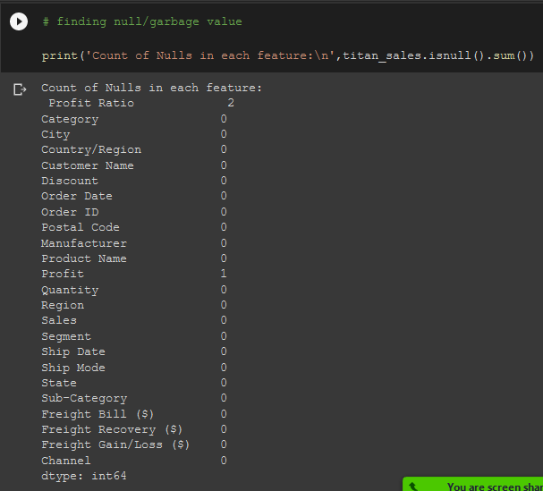
Data Cleaning

Slide 10
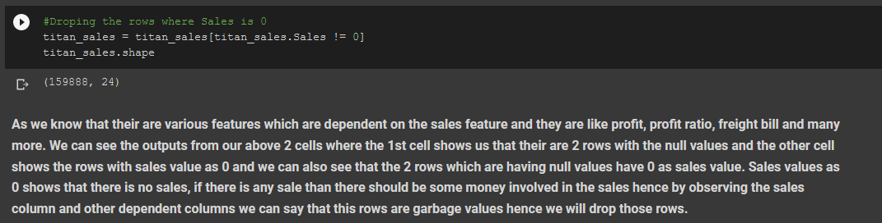
Data Cleaning

Slide 11
Market basket analysis
Getting required columns for Analysis
Titan Sales
Feature Engineering
Association Rule Mining
Filtering Rules
Finding Best Results
Data Visualization

Slide 12
Market basket analysis for Overall data
Total Number Of Transactions: | 159,888
Total Number Of Unique Products: | 1919
Most Frequent Product: | Staple Envelope
Metric | Rules Generated
Support: 0.001 | 60
Confidence >= 0.9 & lift >= 6 | 5

Slide 13
Market basket analysis for Furniture
Total Number Of Transactions: | 16,968
Total Number Of Unique Products: | 380
Most Frequent Product: | KI Adjustable-Height Table
Metric | Rules Generated
Support: 0.0004 | 1450
Confidence >= 0.9 & lift >= 6 | 319

Slide 14
Market basket analysis for Office Supply
Total Number Of Transactions: | 48,200
Total Number Of Unique Products: | 1058
Most Frequent Product: | Staple Envelope
Metric | Rules Generated
Support: 0.0002 | 52404
Confidence >= 0.9 & lift >= 6 | 32514

Slide 15
Market basket analysis for Parts
Total Number Of Transactions: | 79,944
Total Number Of Unique Products: | 1906
Most Frequent Product: | Staple Envelope
Metric | Rules Generated
Support: 0.001 | 78
Confidence >= 0.6 & lift >= 6 | 19

Slide 16
Market basket analysis for Technology
Total Number Of Transactions: | 14,776
Total Number Of Unique Products: | 412
Most Frequent Product: | Logitech Wireless Mouse For Web Scrolling
Metric | Rules Generated
Support: 0.0005 | 1216
Confidence >= 0.8 & lift >= 8 | 304

Slide 17
Market basket analysis for Retail Channel
Total Number Of Transactions: | 99,930
Total Number Of Unique Products: | 1919
Most Frequent Product: | Staple Envelope
Metric | Rules Generated
Support: 0.0009 | 28
Confidence >= 0.8 & lift >= 6 | 2

Slide 18
Market basket analysis for E-commerce Channel
Total Number Of Transactions: | 19,986
Total Number Of Unique Products: | 1919
Most Frequent Product: | Staple Envelope
Metric | Rules Generated
Support: 0.002 | 14
Confidence >= 0.6 & lift >= 6 | 10

Slide 19
Customer segmentation
Getting required columns for Analysis
RFM Analysis
Customer Segments
Titan Sales
Feature Engineering
K-means
Clustering
Customer Segments
Data Visualization
Handling Outliers
Hierarchical

Slide 20
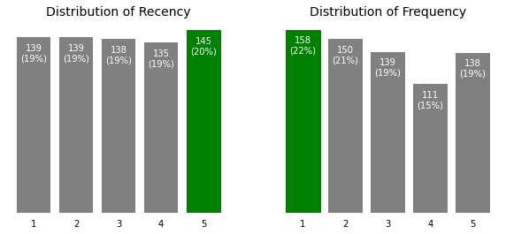
RFM Analysis Results

Slide 21
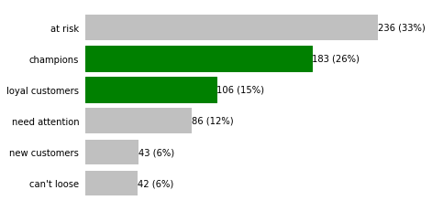
RFM Analysis Results

Slide 22
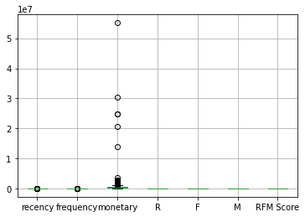
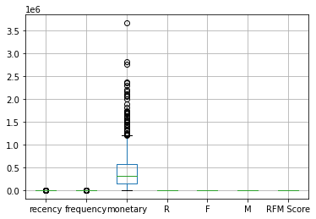
Handling outliers

Slide 23
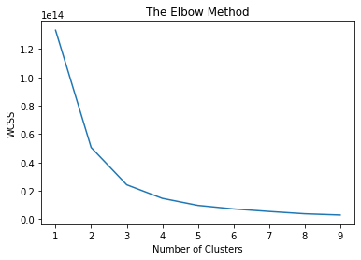
Finding best number of clusters by elbow method

Slide 24
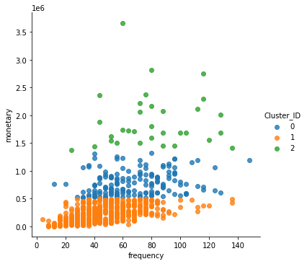
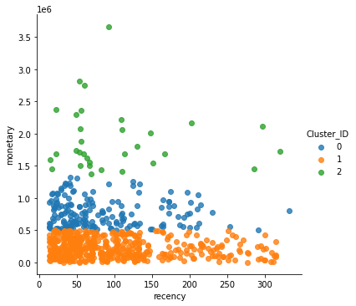
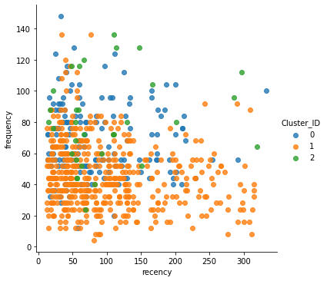
Visualizing clusters by k-means clustering (k = 3)

Slide 25
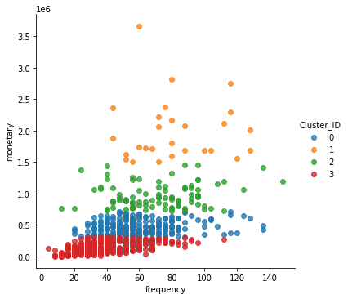
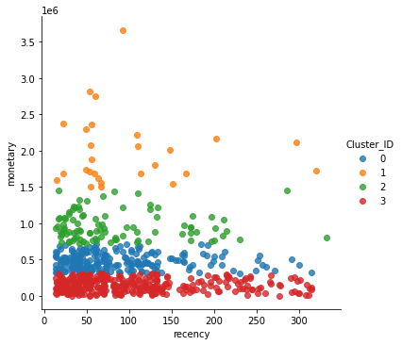
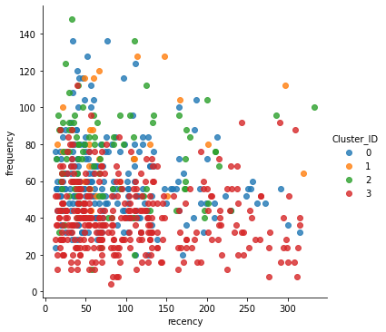
Visualizing clusters by k-means clustering (k = 4)

Slide 26
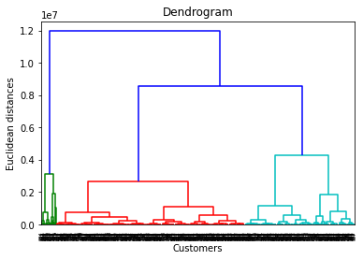
Finding best number of clusters by dendrogram

Slide 27
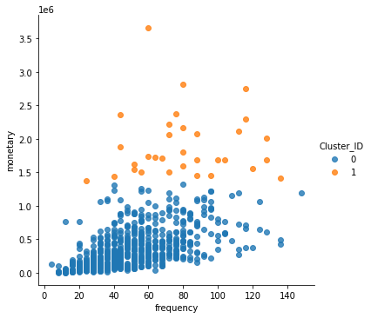
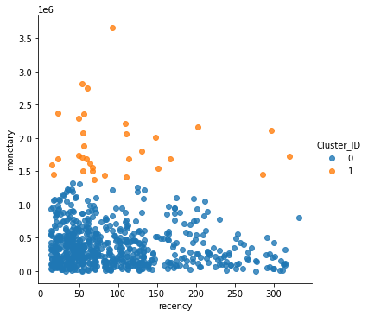
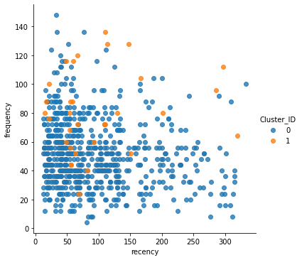
Visualizing clusters by hierarchical clustering (k = 2)

Slide 28
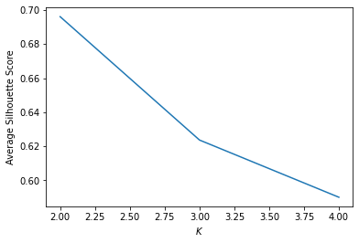
Evaluating clusters by Silhouette score

Slide 29
Sales forecasting
Titan sales
Getting Required Columns for Analysis
Handling Outliers
Feature Engineering
Data Visualization
Moving Average
Exponential Smoothing
SARIMA
Facebook Prophet

Slide 30
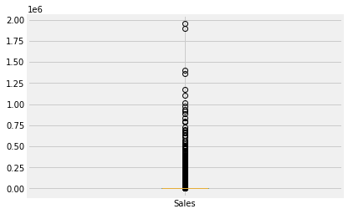
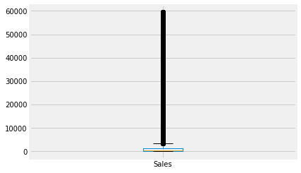
Handing outliers

Slide 31
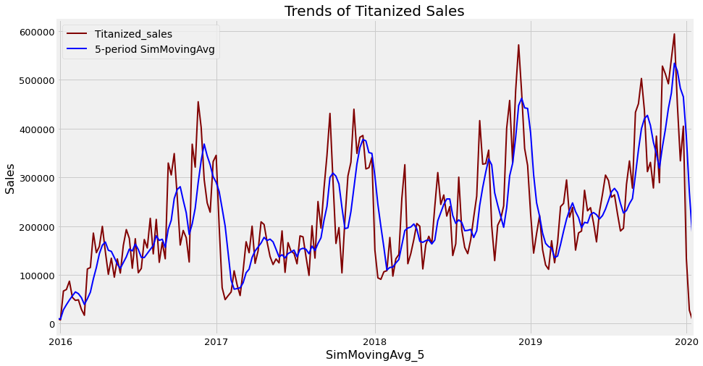
Moving average

Slide 32
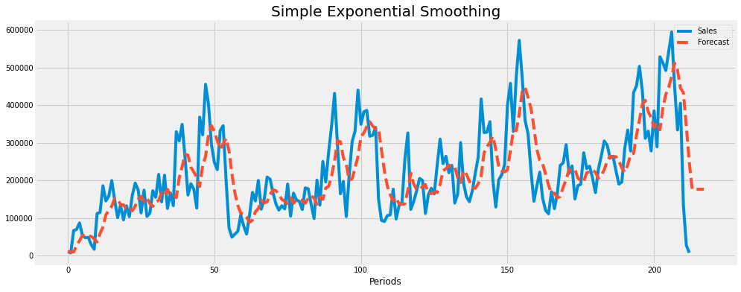
Simple exponential smoothing

Slide 33
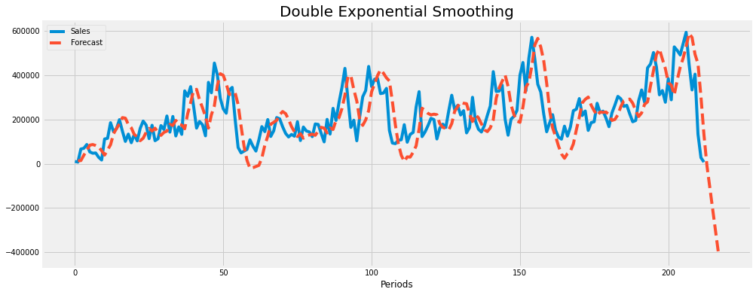
Double exponential smoothing

Slide 34
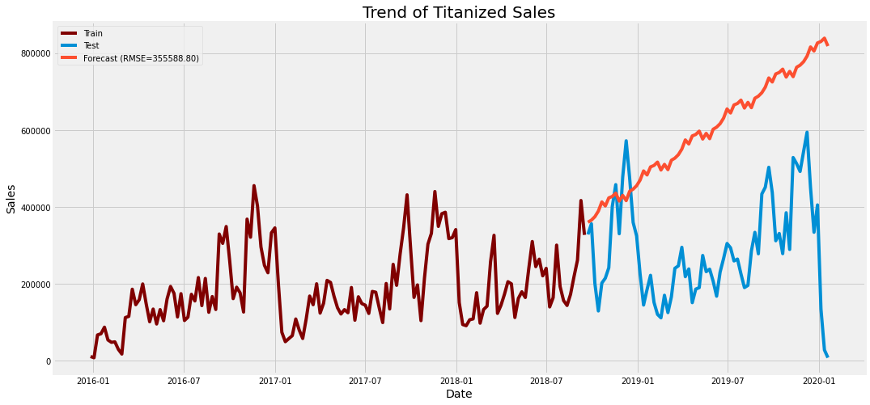
Triple exponential smoothing

Slide 35
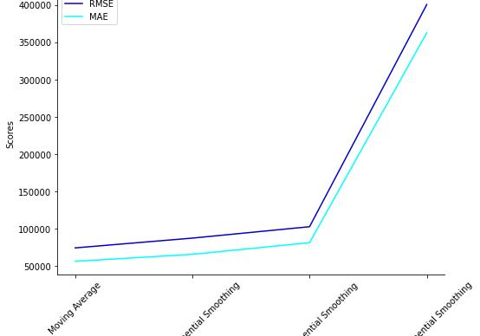
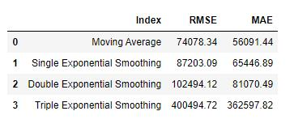
Comparing results of moving average and exponential smoothing models

Slide 36
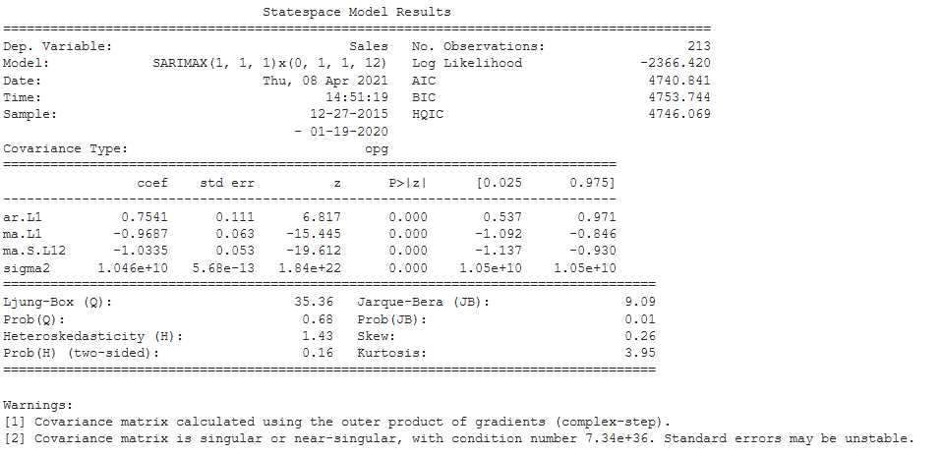
Sarima

Slide 37
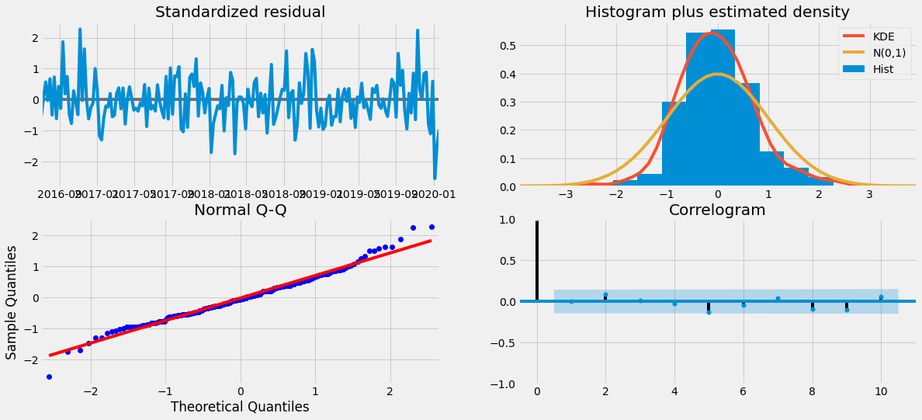
SARIMA Results Diagnostic

Slide 38
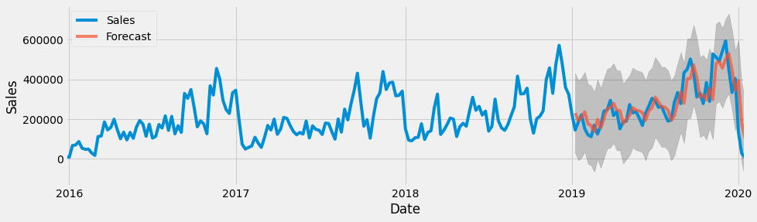
SARIMA Forecasting results of existing data

Slide 39
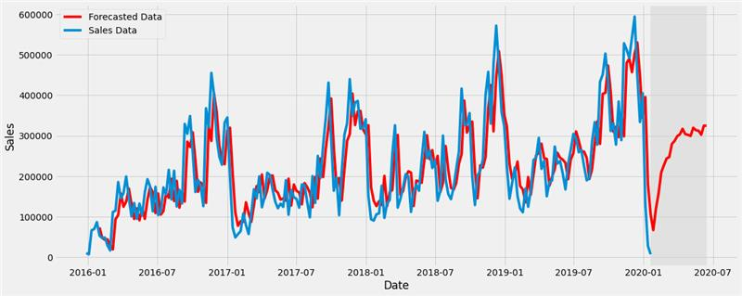
SARIMA Forecasting results of future data (12 steps)

Slide 40
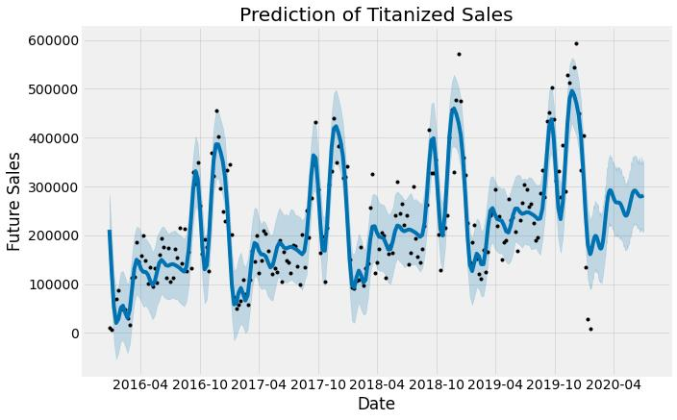
Facebook prophet rESULTS

Slide 41
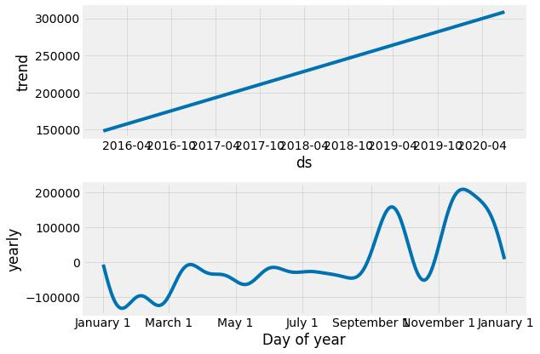
Facebook prophet rESULTS

Slide 42

Tableau visualization

Slide 43
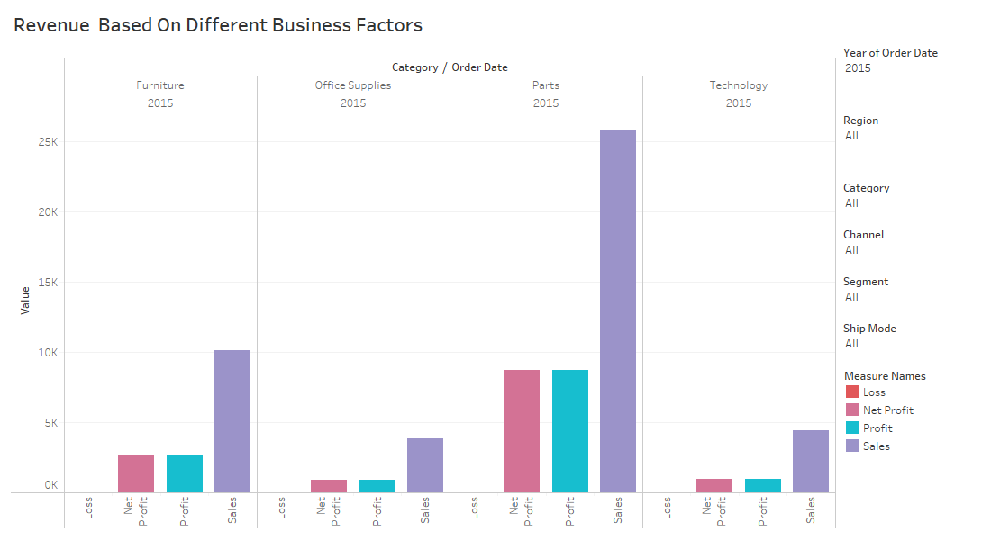

Slide 44
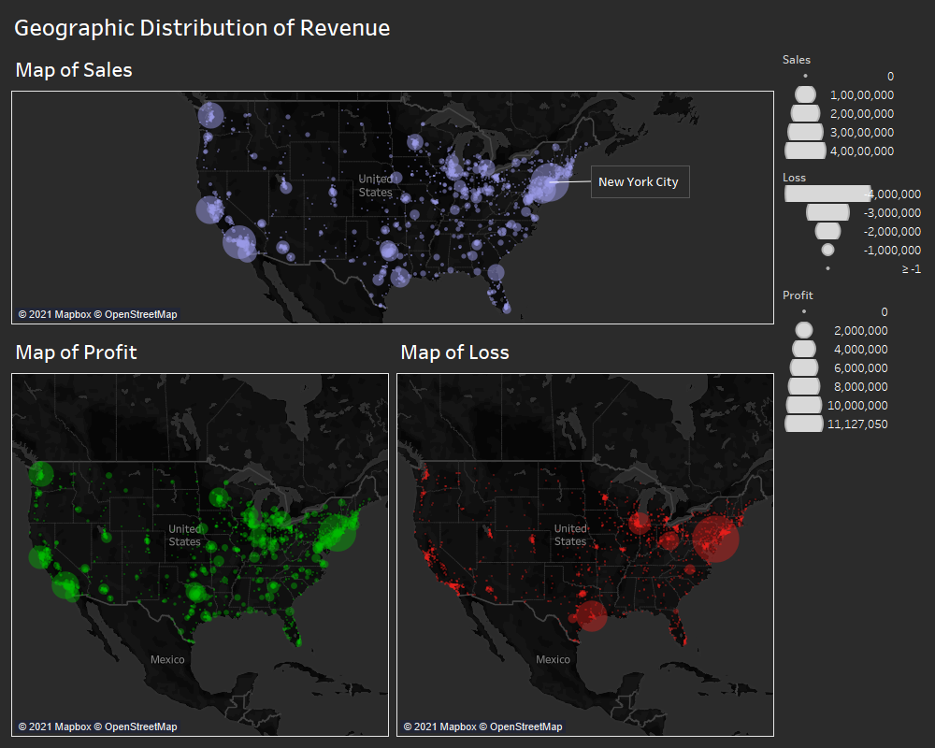

Slide 45
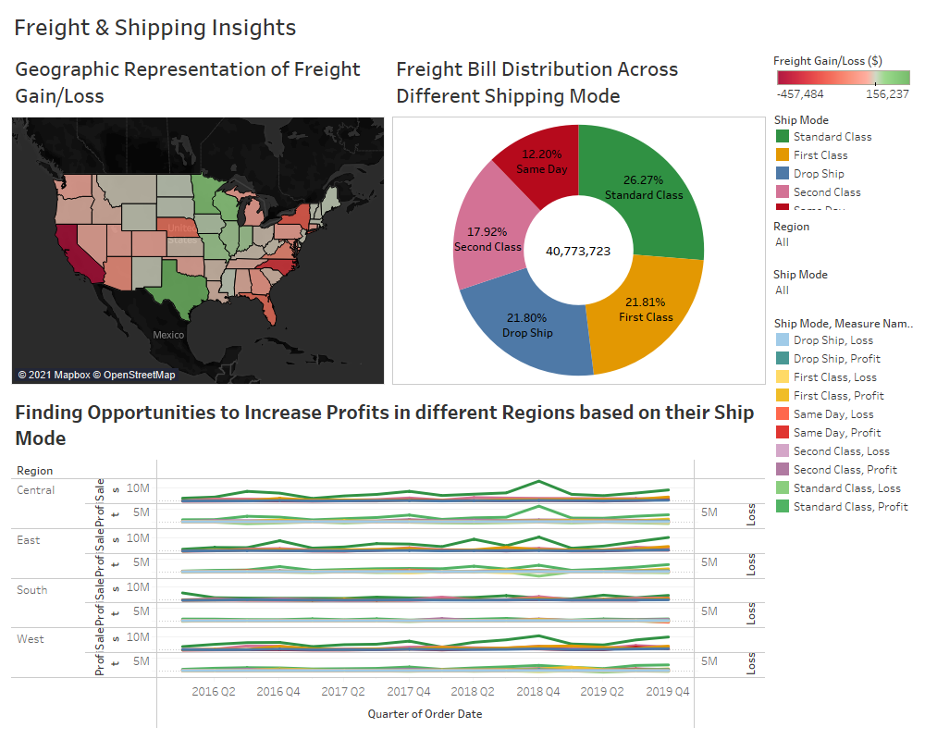

Slide 46
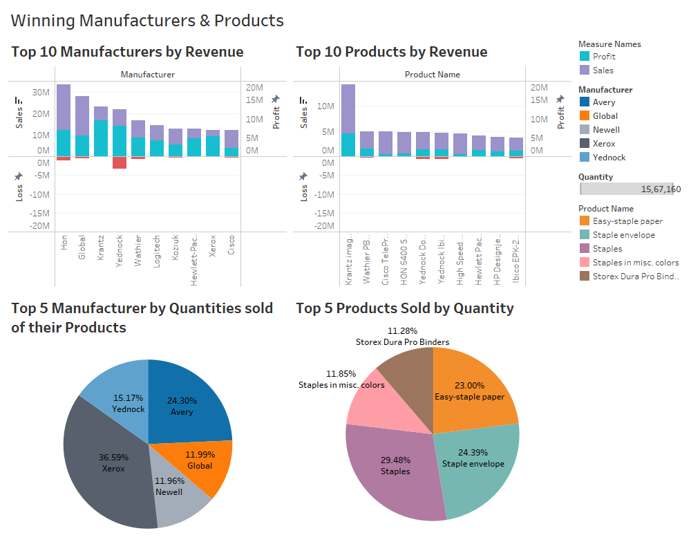

Slide 47
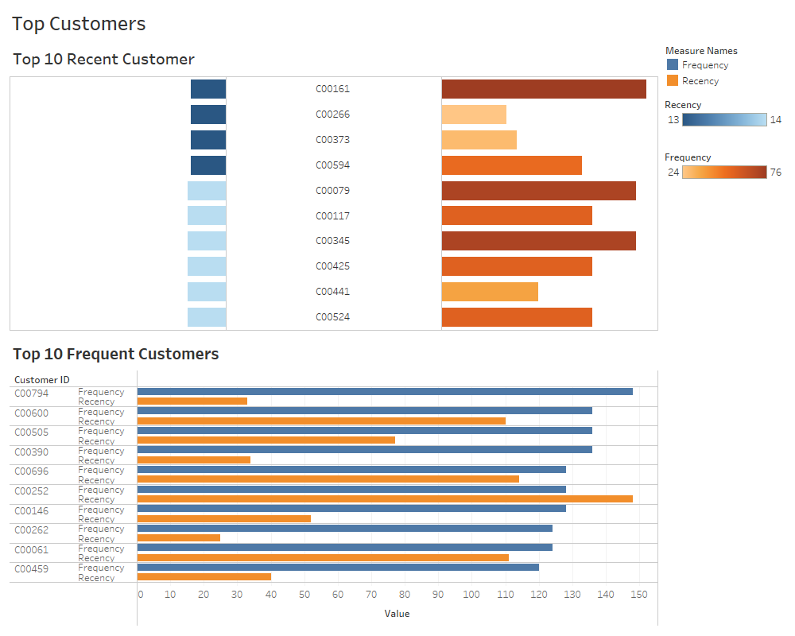

Slide 48
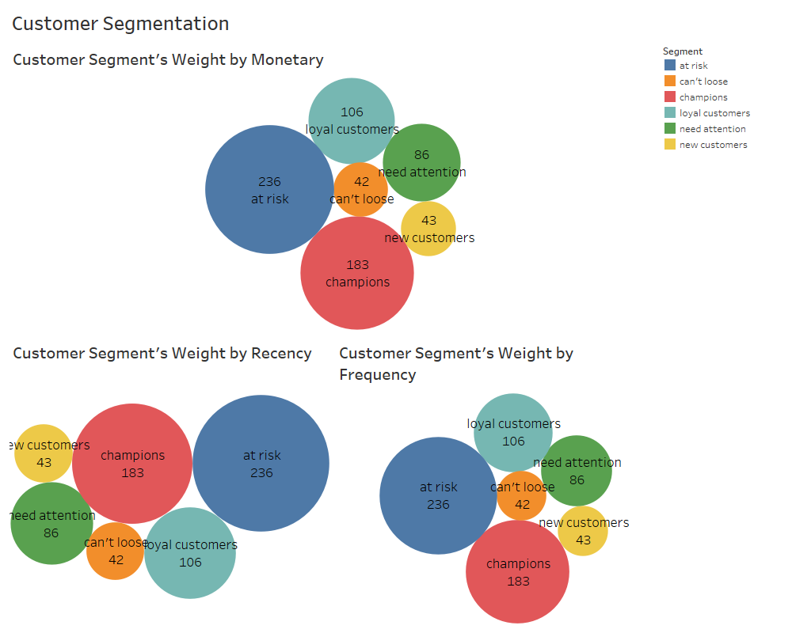

Slide 49
References
https://www.strategytitan.com/blog/titanized-real-world-dataset-to-develop-your-analytics-muscle

Slide 50

Thank you
Group 7
Kushal Patel (0746803)
Viraj Modi (0748396)
Vishakha Parab (0754312)

